Slide 1


RESIDENT MEETING
January 30, 2025
Notes:
Welcome (Sylvia, Tiffany or Amanda)
Here are the question from last meeting. Let’s acknowledge them when they come up throughout the presentation.

Slide 2
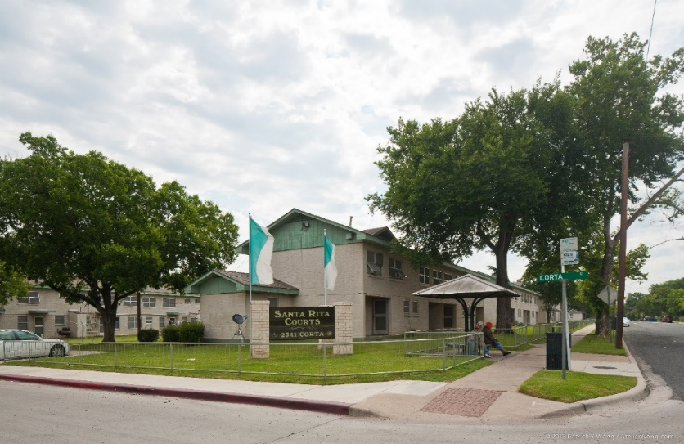
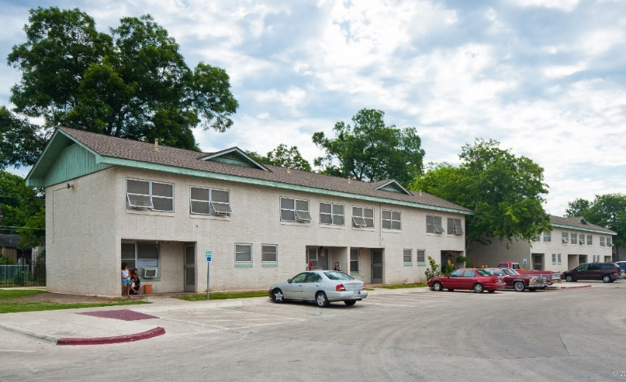
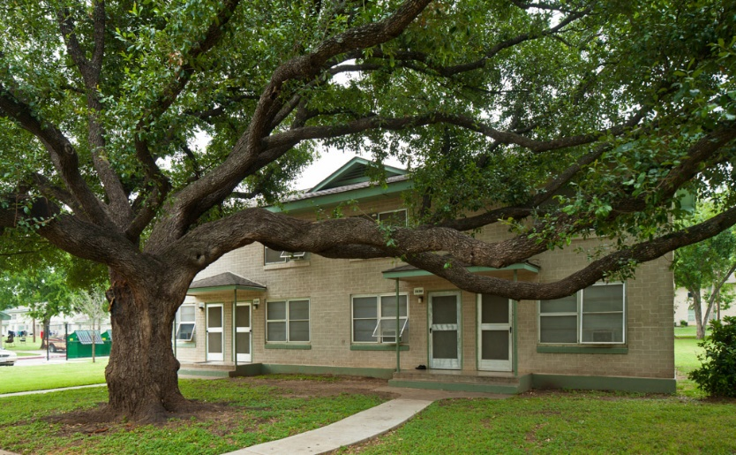

SANTA RITA CURRENT STATE
Antiquated/deteriorating building systems
No Central AC (inefficient window units)
Small living spaces
Little to no accessibility for persons with disabilities
Notes:
Tiffany or Sylvia – No need to dwell on this slide. I just left it in as an acknowledgement of where we’re starting from.

Slide 3
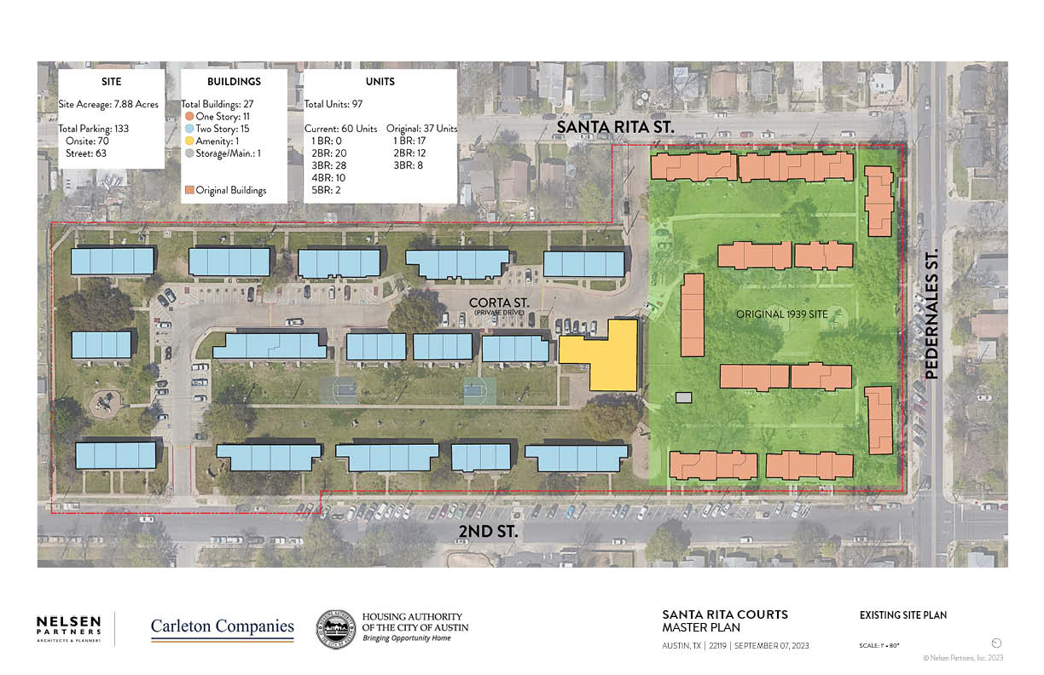
Notes:
Tiffany or Sylvia - Santa Rita site plan today

Slide 4

SANTA RITA EFFORTS TO DATE
Sept 2023- HACA announced redevelopment intentions
Jan 2024- Letters of support
Feb 2024- Residents to City Council
Mar 2024- 9% Tax Credit application due
Jan 2025- 9% Pre-Application Due
Notes:
Tiffany or Sylvia – No need to dwell on the timeline. Again, I just left it in as an acknowledgement of what we’ve done so far. This might be a good place to acknowledge their questions and feedback from the last meeting and let them know we’ll point out answers as we go through the presentation.
Now working on full application for 9% tax credits – almost $20M in funding! Turn it over to Matt.

Slide 5
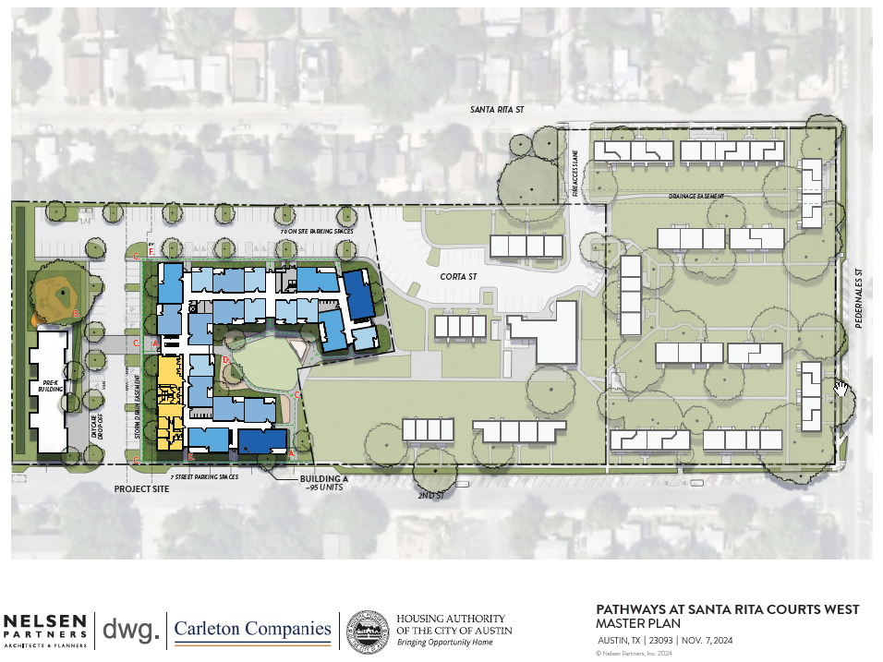
Notes:
Matt, although someone from HACA or Carleton may need to address timing of phase 2 – we want to do them at the same time but funding may not allow it.

Slide 6
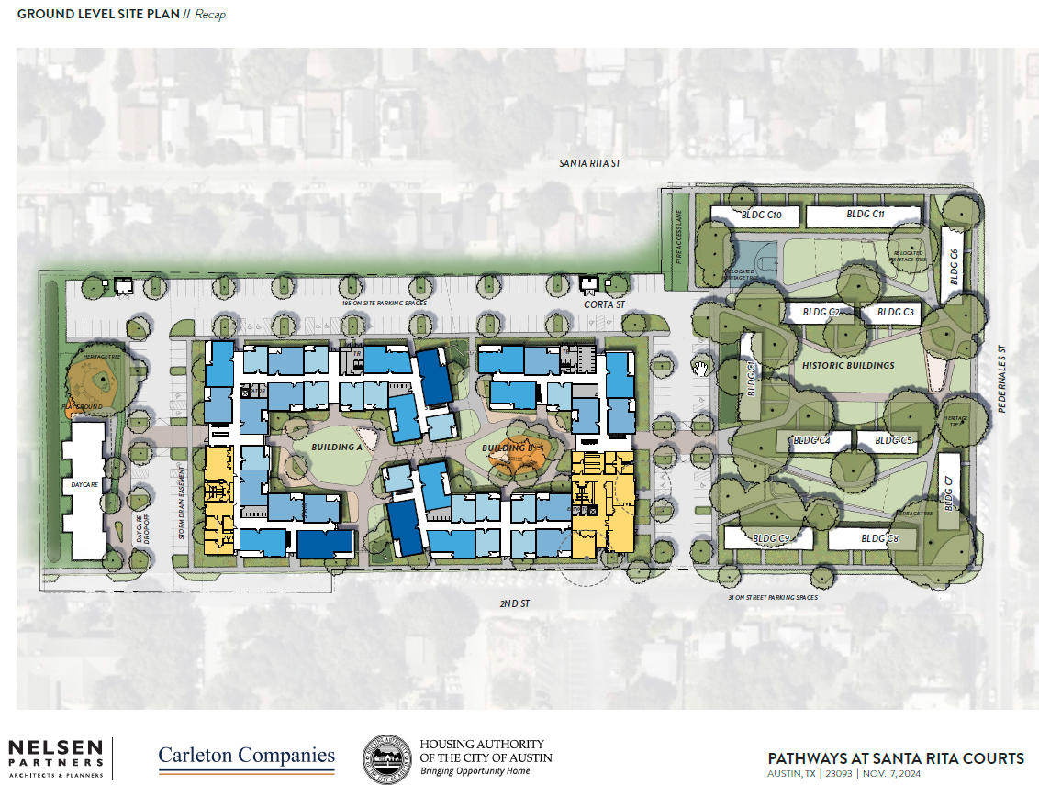
Notes:
Matt

Slide 7
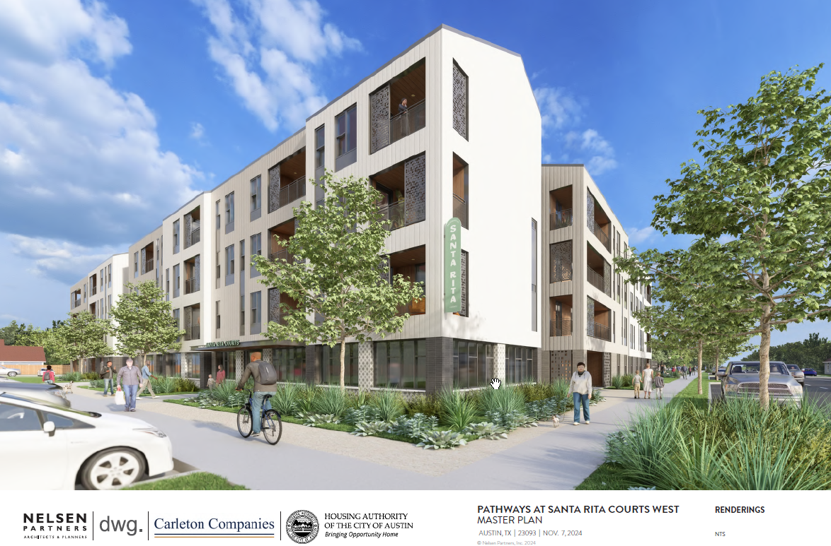
SANTA RITA COURTS WEST
Subject to change
Notes:
Matt

Slide 8
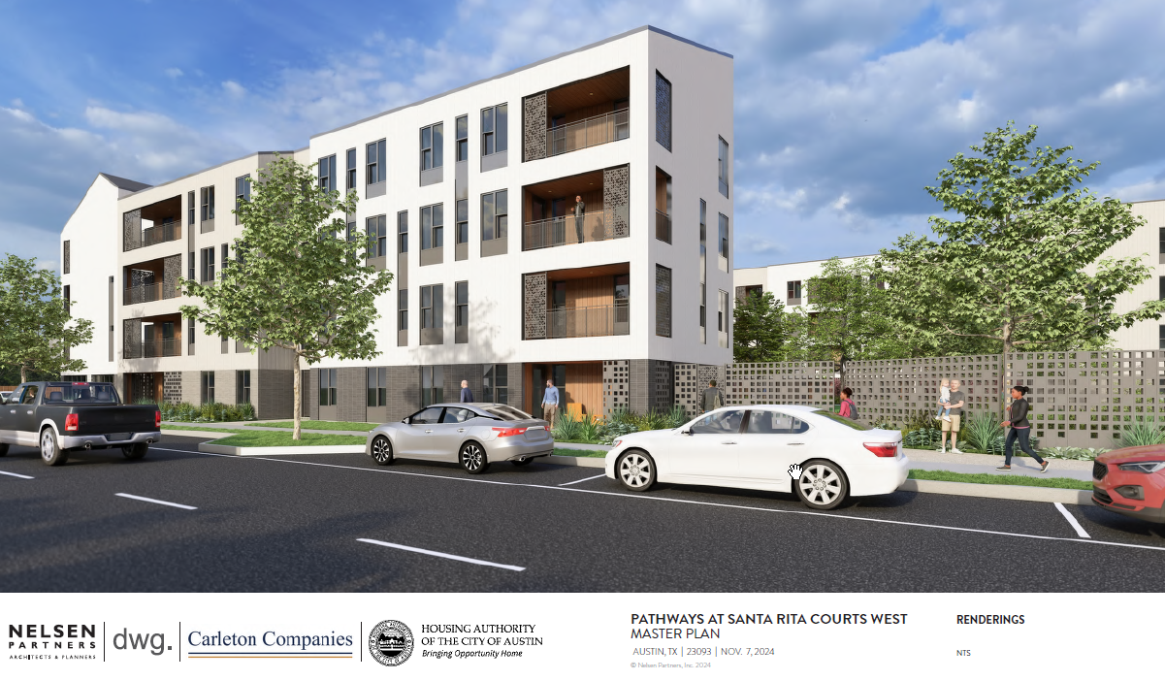
SANTA RITA COURTS WEST
Subject to change
Notes:
Matt

Slide 9
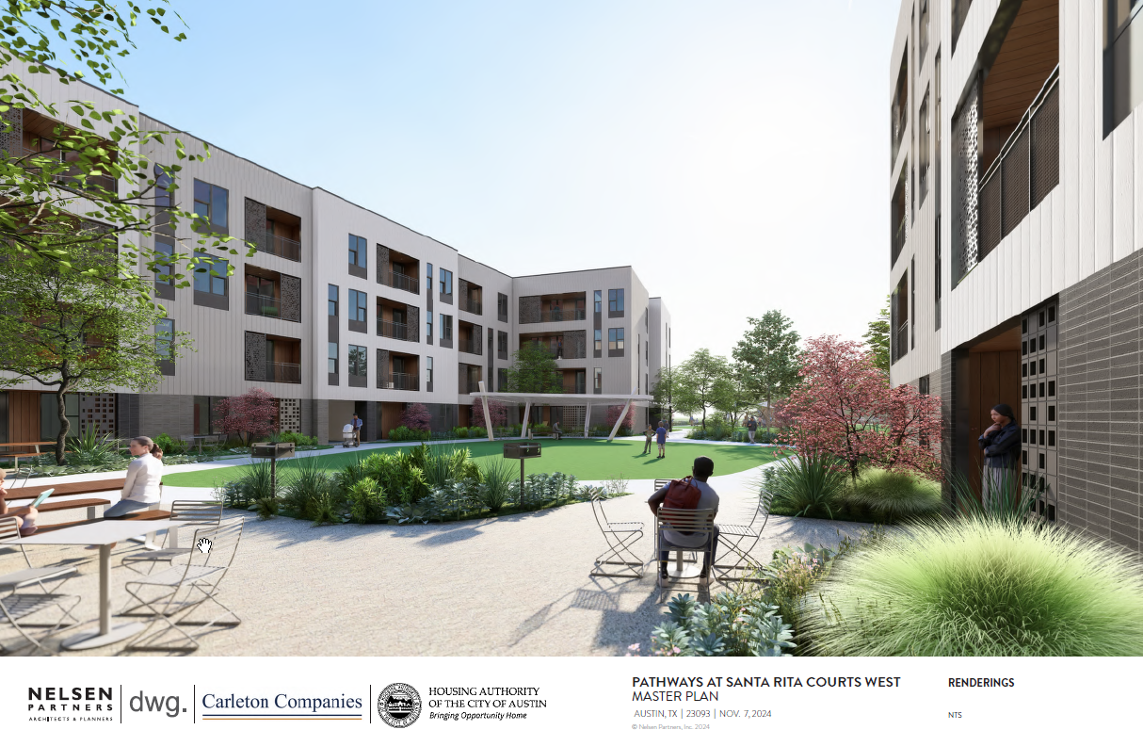
SANTA RITA COURTS WEST
Subject to change
Notes:
Matt

Slide 10
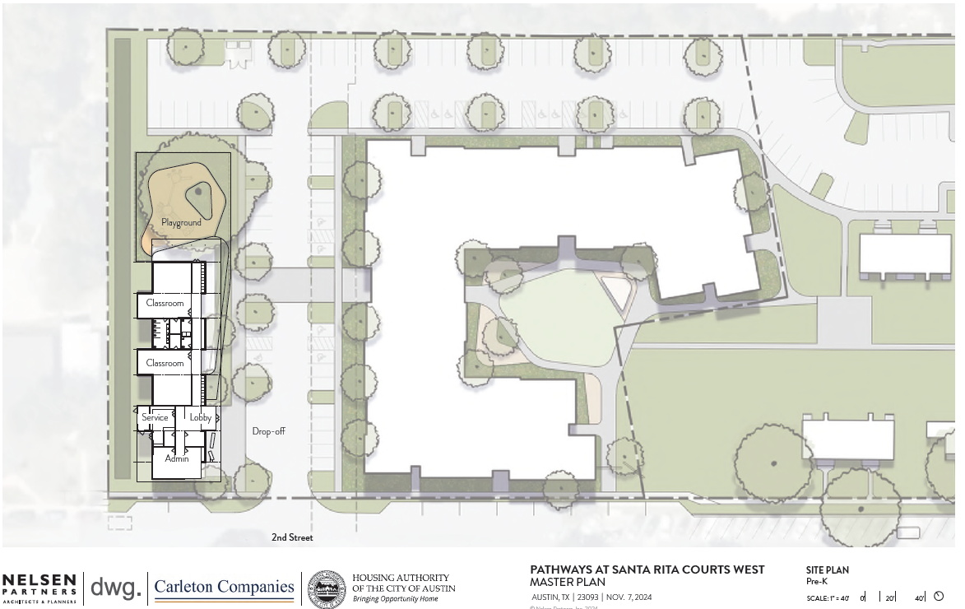
SANTA RITA COURTS WEST
Subject to change
Notes:
Matt

Slide 11
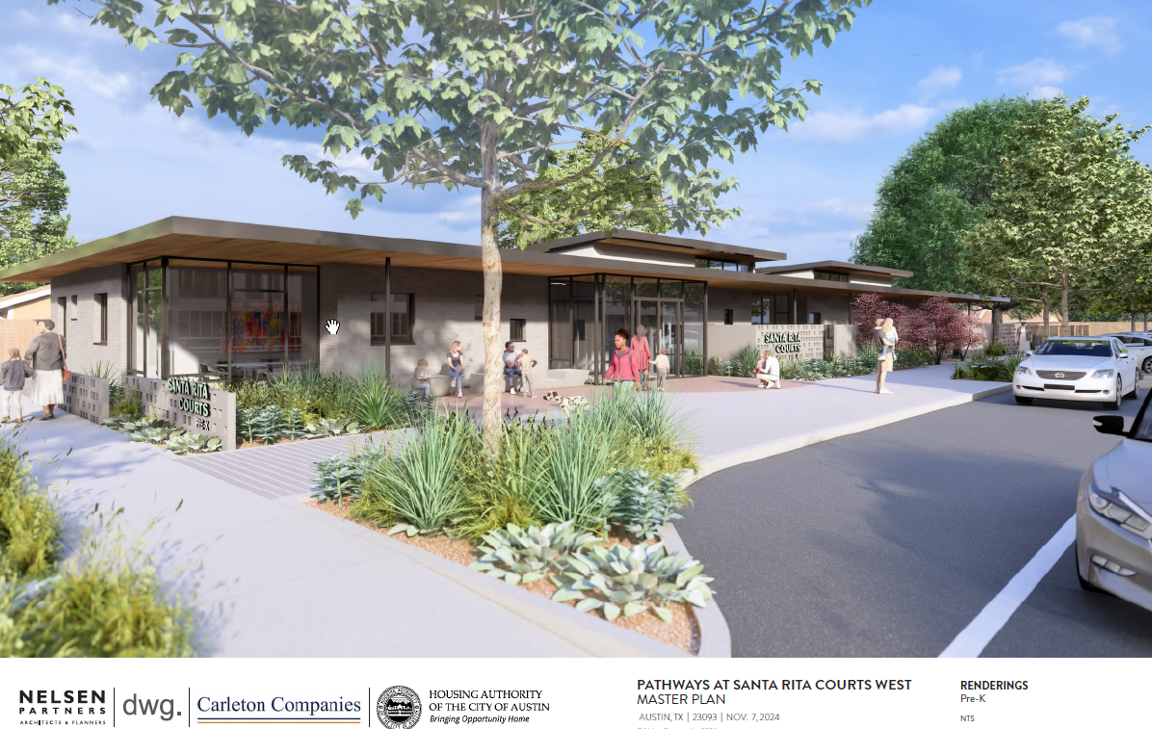
SANTA RITA COURTS WEST – PRE-K
Subject to change
Notes:
Matt, may want someone from HACA to talk about partnership with Mainspring

Slide 12
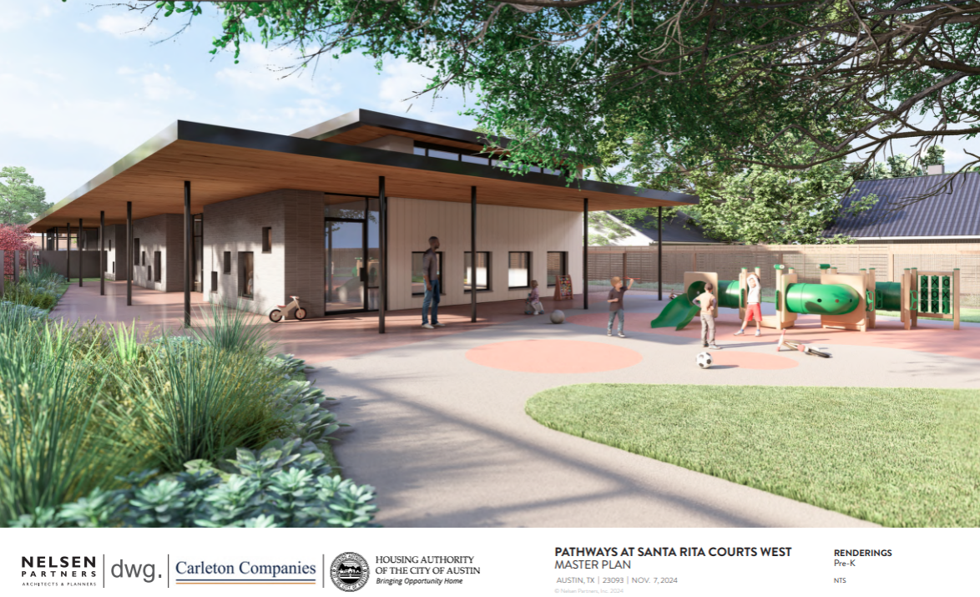
SANTA RITA COURTS WEST – PRE-K
Subject to change

Slide 13
SANTA RITA RELOCATION
GUIDING PRINCIPALS
P = Protections
I = Improvements
C = Choice
Notes:
Tiffany

Slide 14
SANTA RITA RELOCATION
  OFFICIAL NOTICES
General Information Notice (GIN)
Notice of Eligibility (NOE)
90 Day Notice
Notes:
Tiffany

Slide 15
SANTA RITA RELOCATION
  PREPARATION
Credit Check
Pest Control: Report concerns
Housekeeping: Time to declutter and take inventory
Notes:
Tiffany

Slide 16
SANTA RITA Relocation
RELOCATION CONSULTANT
To provide counseling and service coordination
Survey each household to assess relocation needs
Provide solutions to barriers
Notes:
Tiffany

Slide 17

TENTATIVE TIMELINE
2023 and 2024
- Planning and Design
2025
Apply for funding
Community engagement
Relocation – end of 2025/early 2026
2026
Construction begins
2027
Return to Santa Rita West! – end of 2027
Subject to change
Notes:
Tiffany – Subject to change

Slide 18
HOW CAN YOU HELP?
Ask questions
Share info with neighbors
Send comments to: AdelanteSantaRita@hacanet.org
Notes:
Tiffany

Slide 19

https://www.hacanet.org/adelante-santa-rita/
AdelanteSantaRita@hacanet.org
Notes:
Questions?

