Slide 1
COMMUNITY MEETING
SEPTEMBER 9, 2023

Slide 2
MEETING GROUND RULES
Be clear.
Give space for others’ input.
Share differing viewpoints, respectfully.
Be concise so we can hear from as many people as possible.
Additional topics will be placed in a “parking lot.”

Slide 3
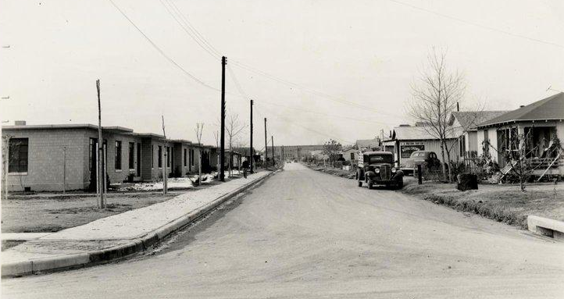
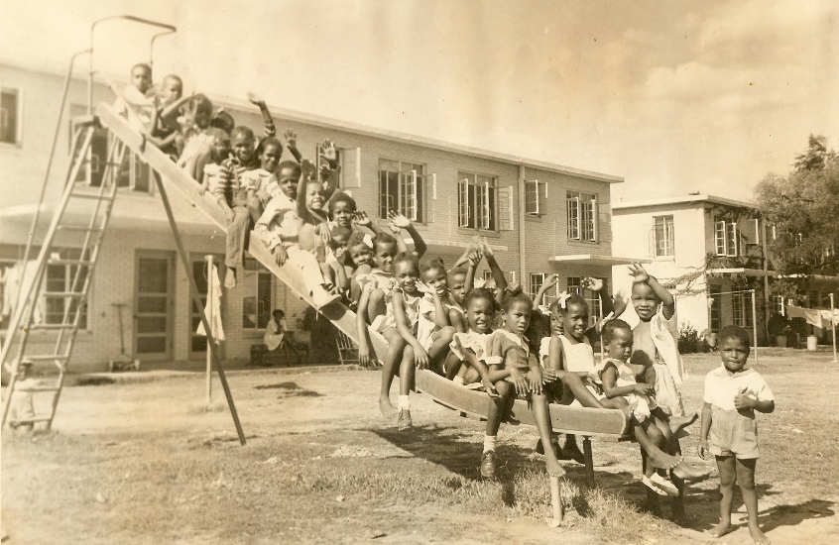
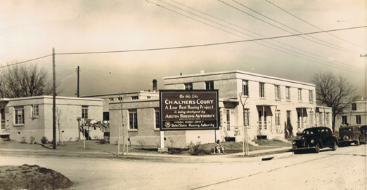
PUBLIC HOUSING IN AUSTIN 1939
These properties—Santa Rita, Chalmers, and Rosewood--were among the first public housing projects created under the U.S. Housing Act of 1937. The developments represented an important aspect of President Franklin Roosevelt’s New Deal program and were intensely championed by then-Congressman Lyndon Baines Johnson. They were built by HACA from 1938 to 1940.

Slide 4
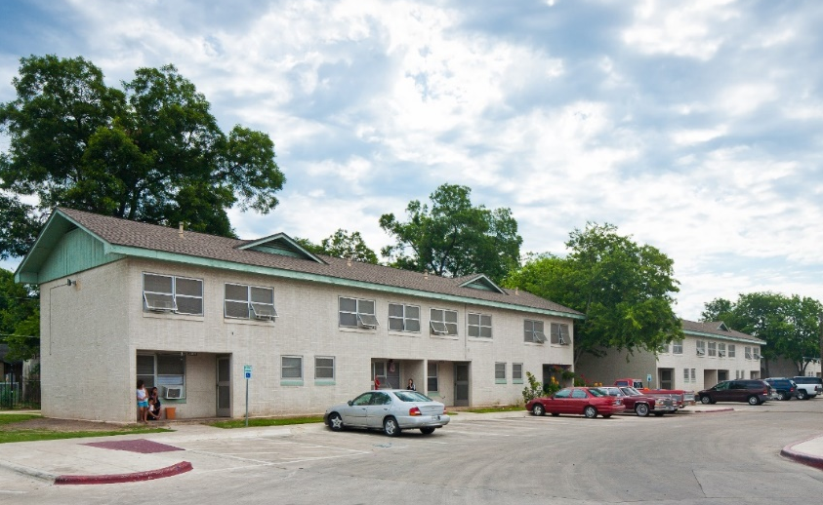
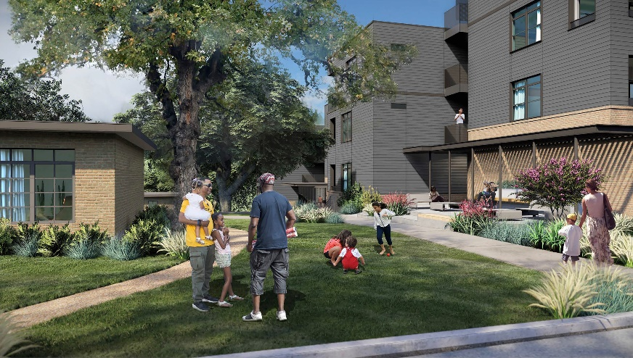
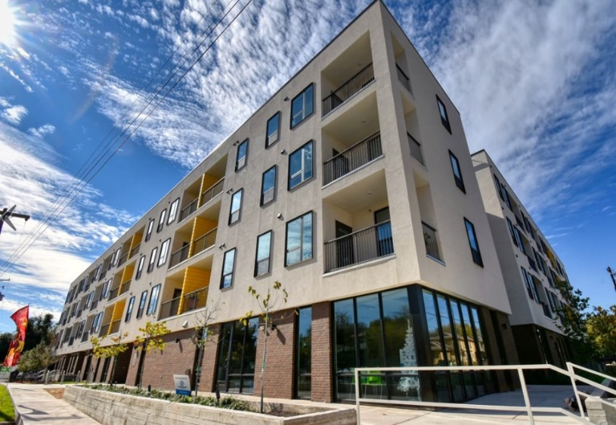
PUBLIC HOUSING IN AUSTIN 1939
Under the Rental Assistance Demonstration (RAD) program, HACA’s traditional public housing transitioned to a long-term subsidy platform that allows for new resources to upgrade properties.
HACA’s primary goals:
Revitalize aging facilities to expand the number of units serving low-income families;
Providing residents with health and wellness services, job training, and educational support; and,
Preserving the historic legacy of properties and maintaining neighborhood communities.

Slide 5
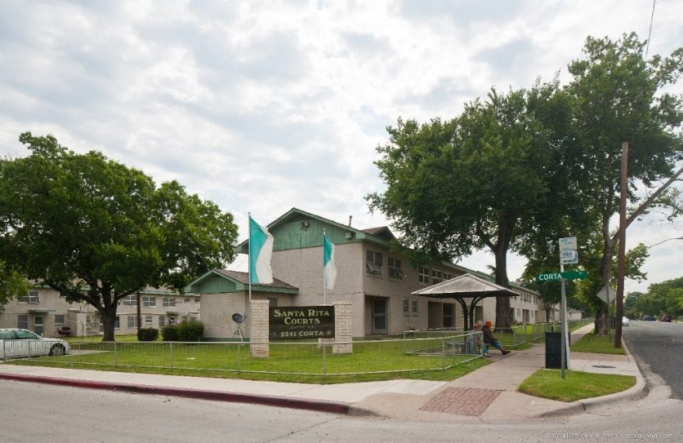
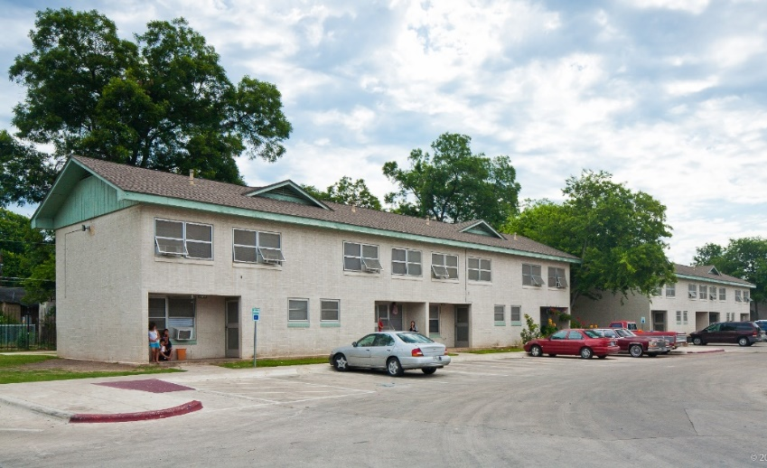
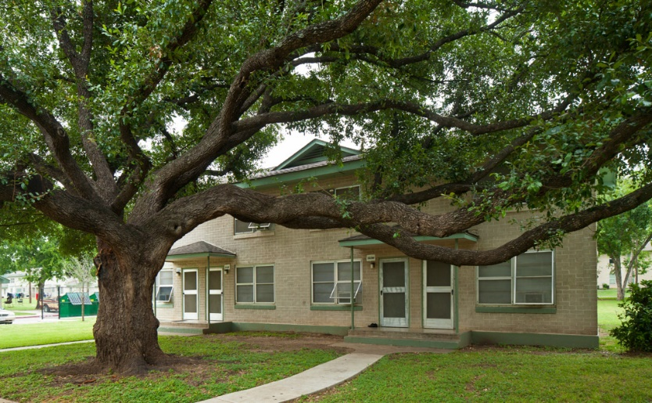
SANTA RITA CURRENT STATE
Antiquated/deteriorating building systems
No Central AC (inefficient window units)
Small living spaces
Little to no accessibility for persons with disabilities

Slide 6
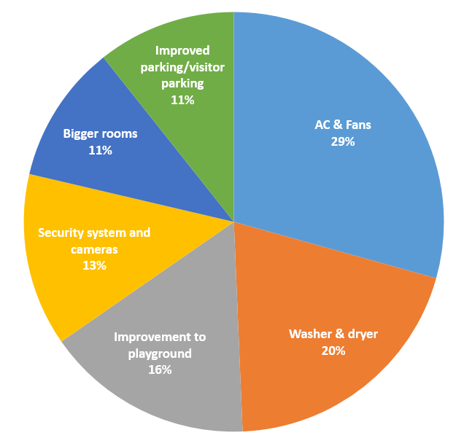
SANTA RITA RESIDENT INPUT
HACA conducted a survey with Santa Rita residents last spring to understand their priorities for desired improvements to the property.
Here are the responses:

Slide 7
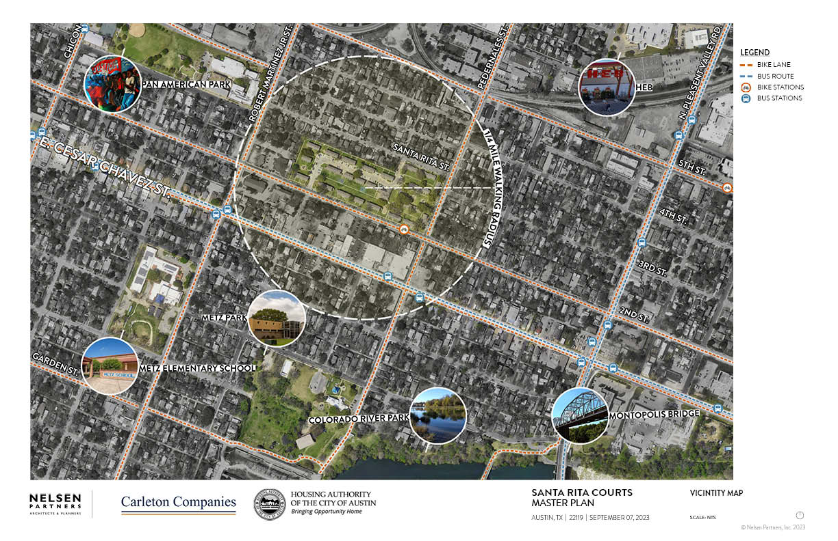

Slide 8
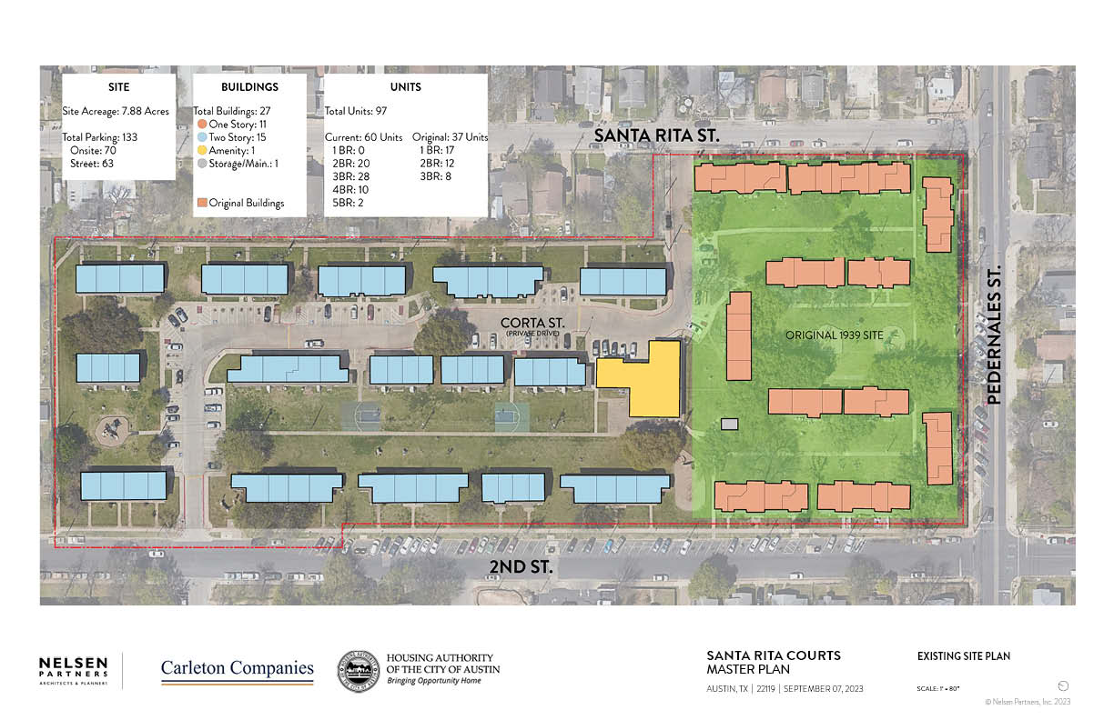

Slide 9
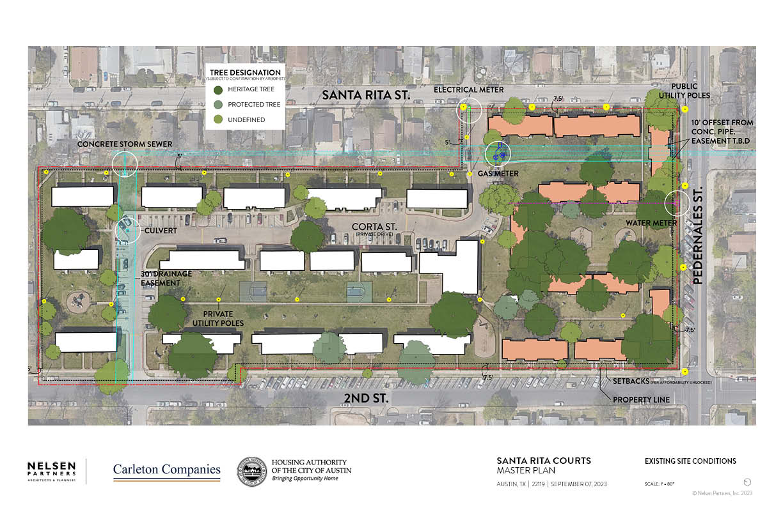

Slide 11
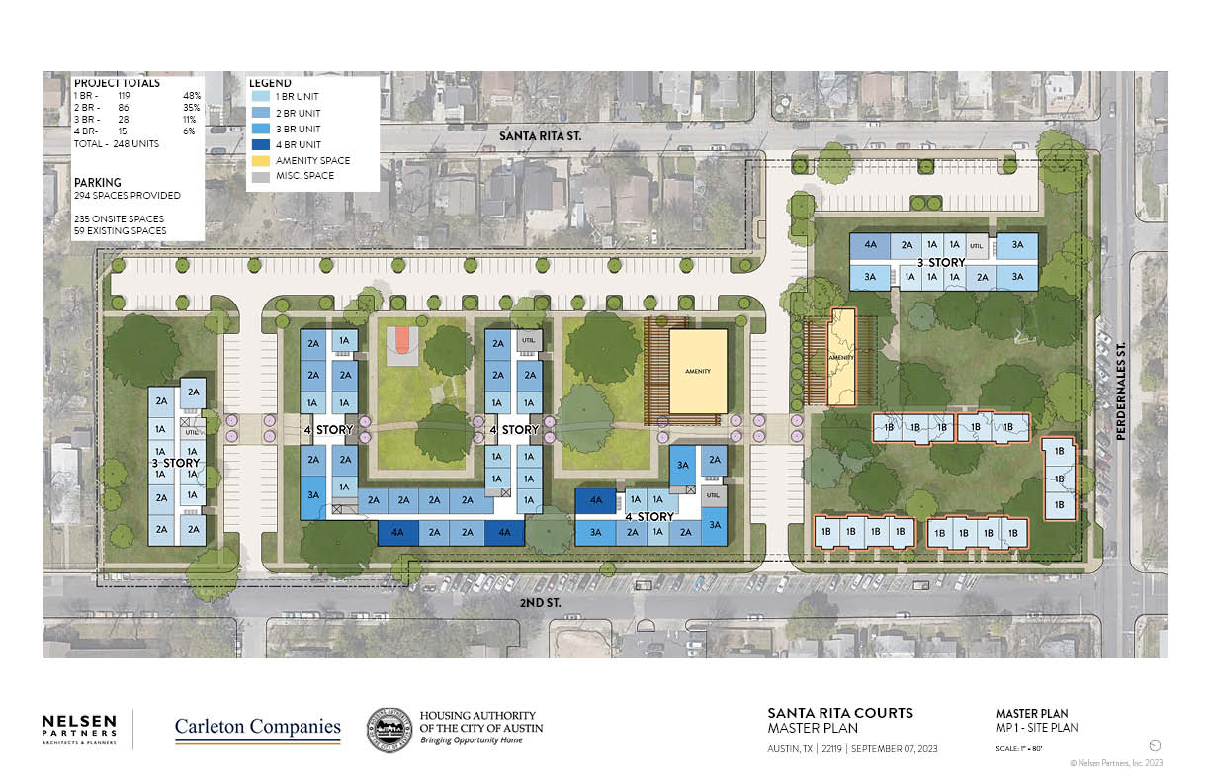

Slide 12
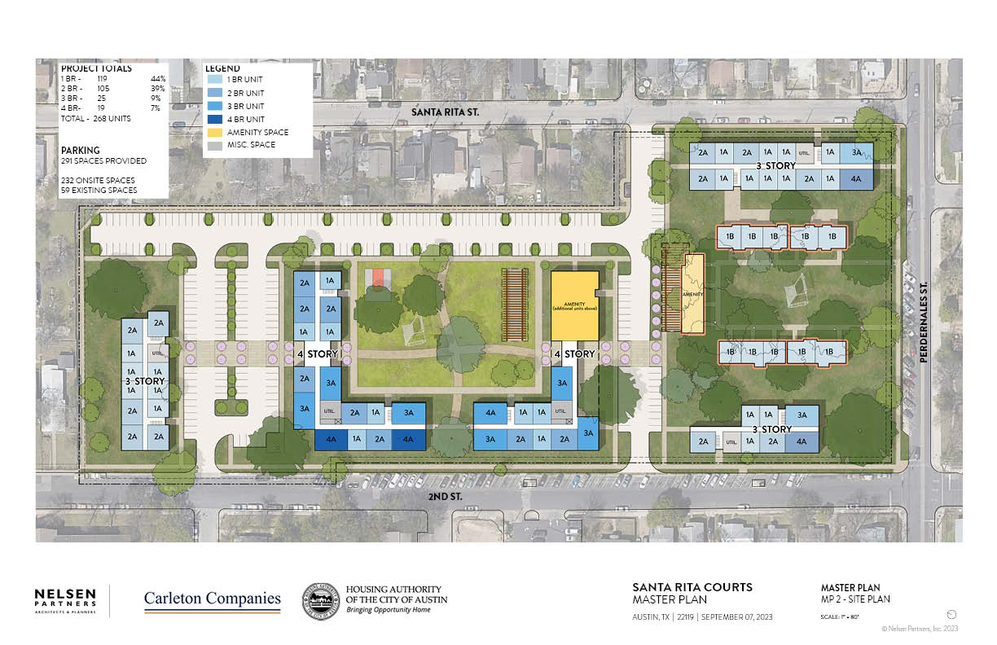

Slide 13
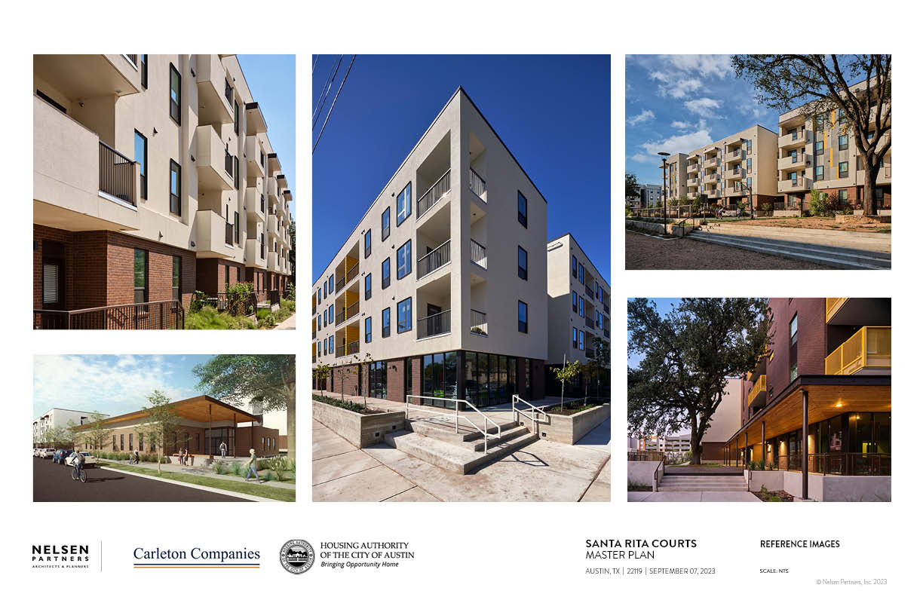

Slide 14
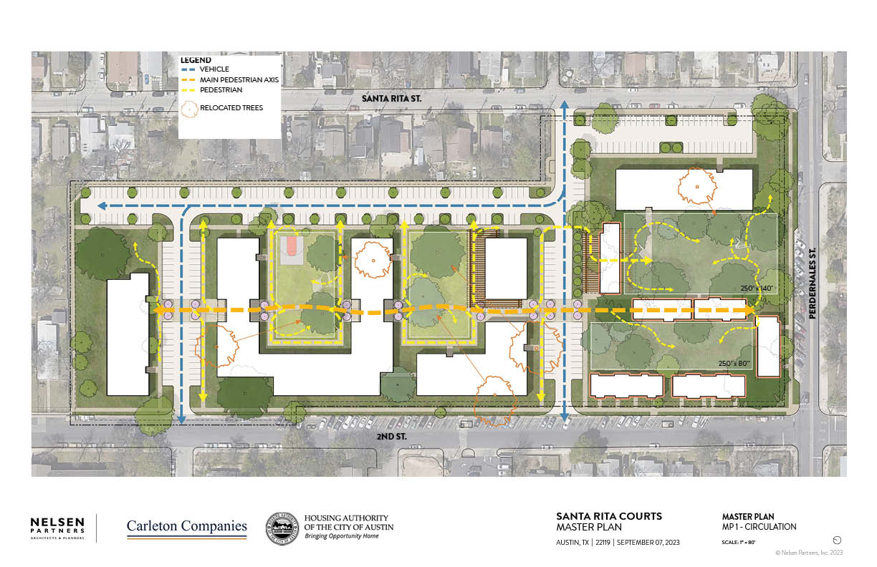

Slide 15
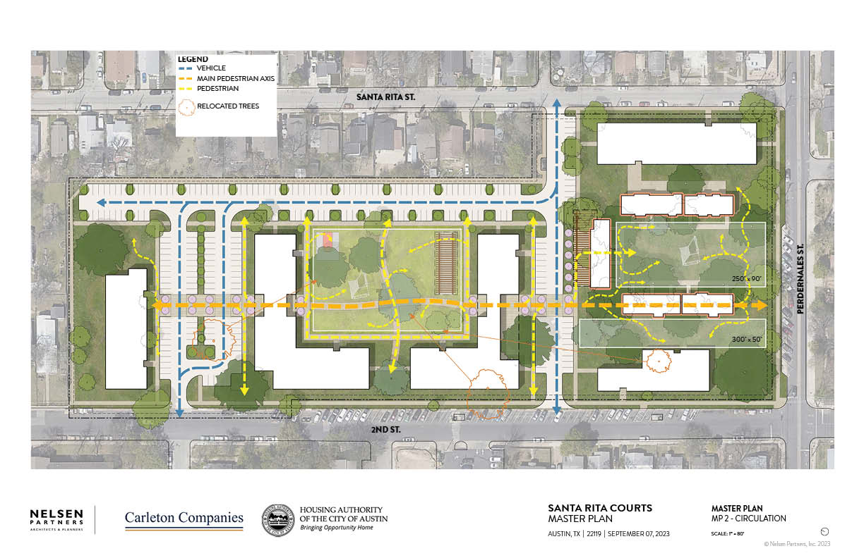

Slide 16
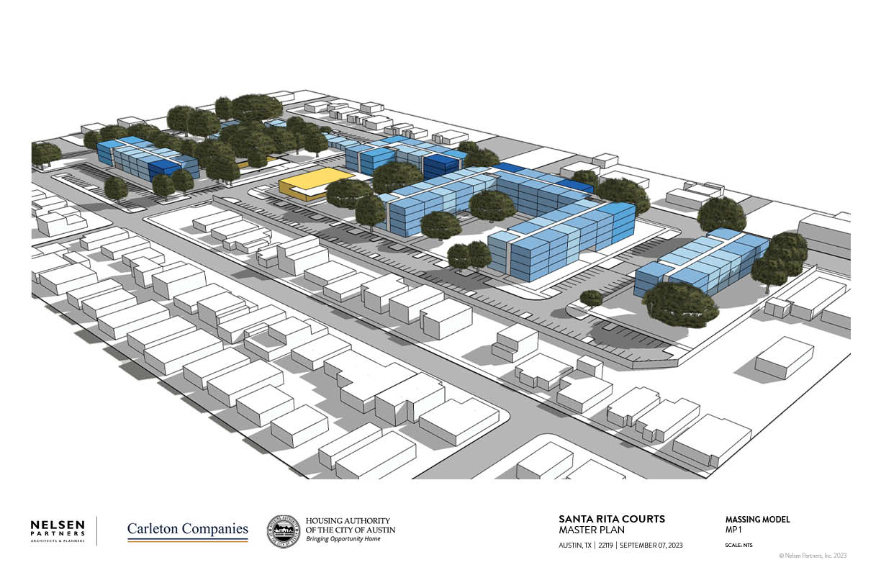

Slide 17
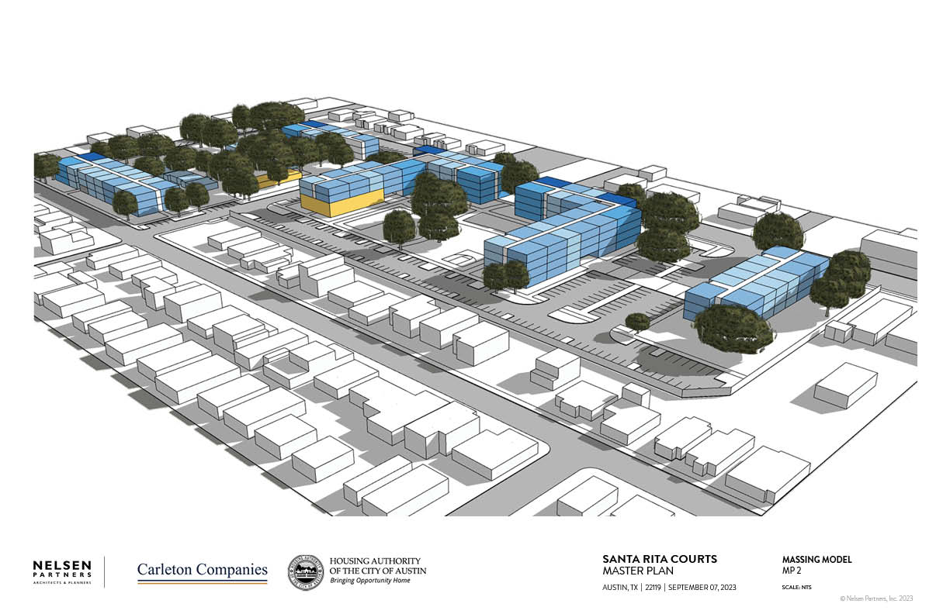

Slide 18
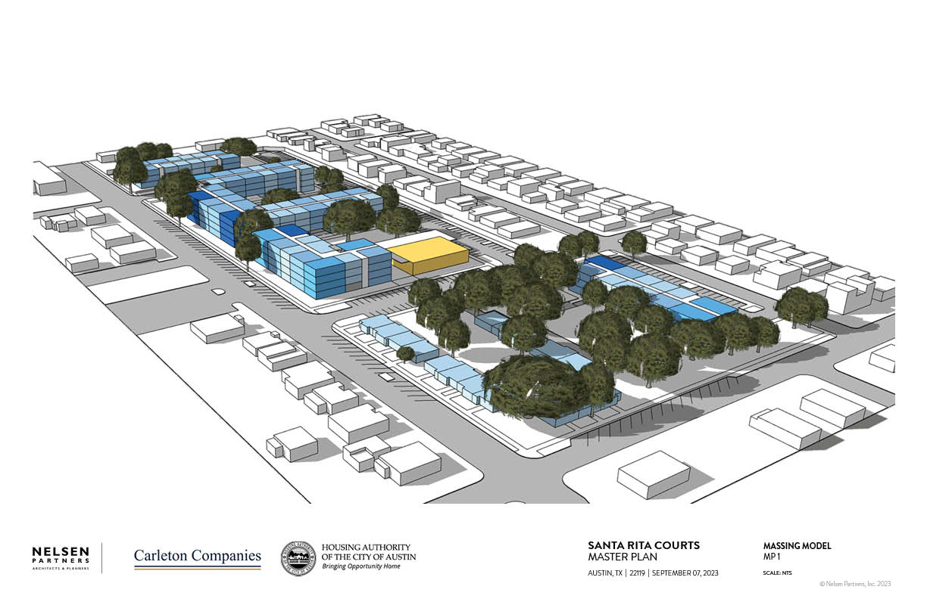

Slide 19
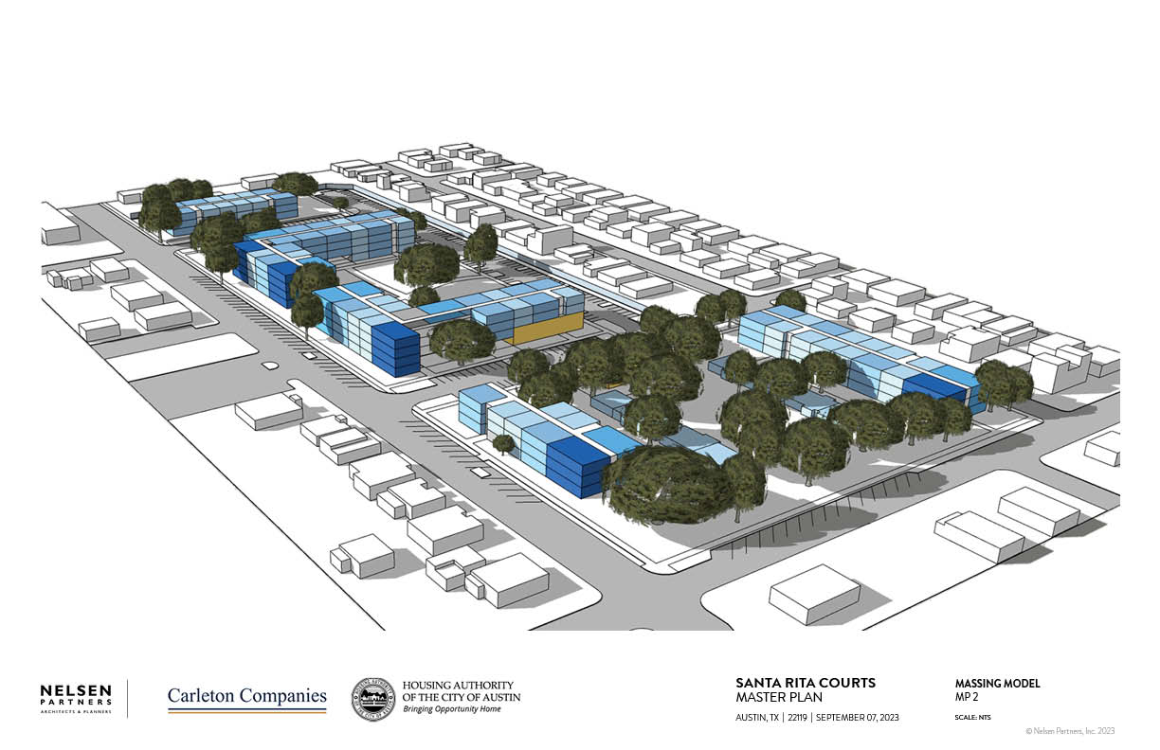

Slide 20
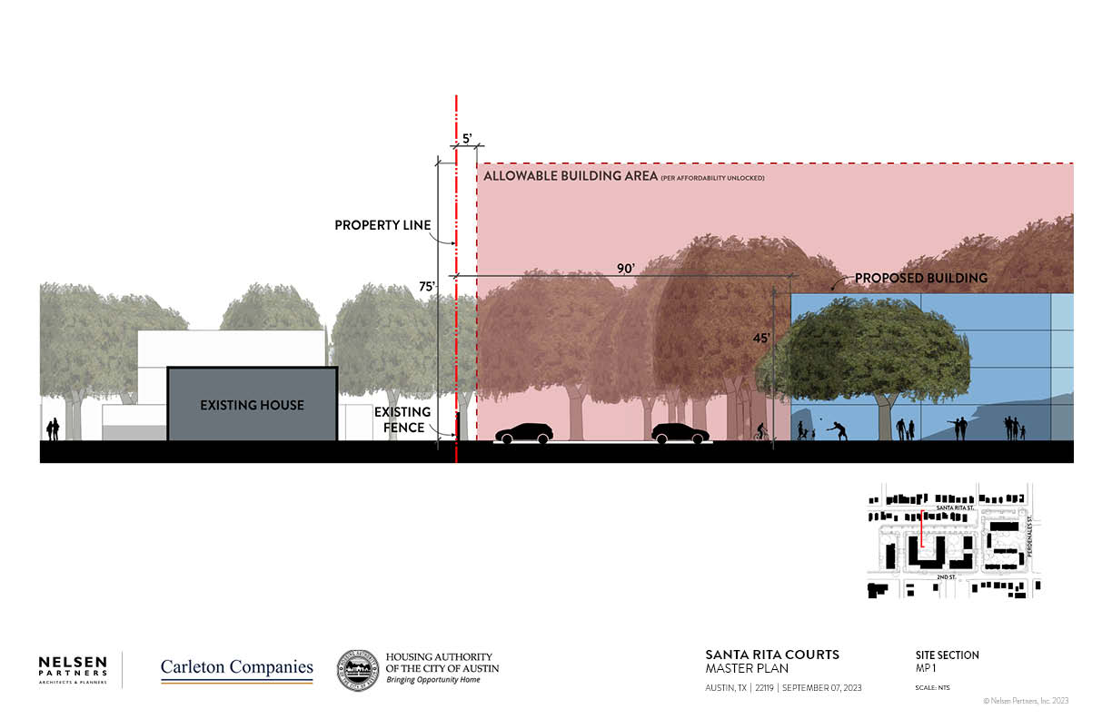

Slide 21
PLAN 1
PLAN 2

Slide 22
TENTATIVE TIMELINE
2023
- Planning and Design
2024
- Apply for funding
2025
- Construction

Slide 23
HOW CAN YOU HELP?
https://www.surveymonkey.com/r/C7H9PKK
Survey Link
Ask questions
Fill out survey
Share info with neighbors
Send comments to: AdelanteSantaRita@hacanet.org
https://www.surveymonkey.com/r/C7H9PKK

Slide 24
https://www.hacanet.org/adelante-santa-rita/
AdelanteSantaRita@hacanet.org

Slide 25
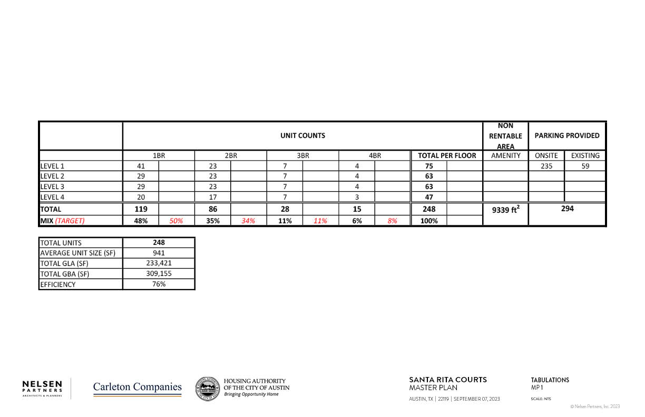

Slide 26
