Slide 1
Welcome!

Slide 2
Vision
We envision neighborhoods where poverty is alleviated, communities are healthy and safe, and all people can achieve their full potential.
MISSION
To cultivate sustainable affordable housing communities and partnerships that inspire self reliance, growth, and optimism.

Slide 3
Housing Choice Voucher Program
“Bringing Opportunity Home”

Slide 4
Overview of Housing Choice Voucher (HCV) Program
Involved Parties’ Roles and Responsibilities
Compliance with HCV Program
Step by Step Process to Lease with HCV
Questions

Slide 5
HCV Program was developed in 1974 by the Housing and Community Development Act.
Program is funded by the U.S. Department of Housing and Urban Development and administered by the Housing Authority of the City of Austin (HACA).
Federally funded program that helps families more easily afford rent.
Housing Choice Voucher (HCV) Program

Slide 6
Families choose a unit in the private rental market.
Families pay between 30 – 40% of their income toward rent directly to the owner.

Slide 7
Voucher
HAP Contract
HCV Program is a 4-way partnership between HUD, HACA, the Landlord, and the Family.
Lease
Family
Landlord

Slide 8
Interview and screen families for renter suitability.
Maintain the property in compliance with Housing Quality Standards (HQS) and makes necessary repairs.
Collect monthly rent portion, security deposits, and application fees.
Manage the property and enforce the lease.
Landlord’s Role
& Responsibilities

Slide 9
Complies with fair housing laws and equal opportunity requirements.
Notifies HACA if the tenant vacates the property or someone new is living in the unit.
Complies with the Housing Assistance Payment (HAP) contract, tenancy addendum, and lease.
Landlord’s Role
& Responsibilities

Slide 10
Explain program rules to families and property owners and enforce regulations.
Initially and annually review family’s household composition and income.
Inspect properties for compliance with Housing Quality Standards (HQS) and conduct rent reasonable surveys based on the private market.
HACA’s Role
& Responsibilities

Slide 11
Calculate the family’s share of the rent and pay HACA’s rent portion to the property owners on behalf of the participant.
Update the family’s rent portion when household income or composition changes.
HACA’s Role
& Responsibilities

Slide 12
Attend scheduled appointments with HACA.
Report changes in family composition and household income to HACA within 30 days of change.
Provide HACA complete and accurate information by requested due date.
Locate a suitable unit before the voucher expires.
Family’s Role
& Responsibilities

Slide 13
Maintain the unit in good, safe, decent, and sanitary condition.
Sign a lease with landlord and comply with terms of the lease.
Pay assigned rent portion on time to the landlord.
Comply with family obligations under the HCV Program.
Family’s Role
& Responsibilities

Slide 14
Family Obligations
Family must pay their portion of the rent to landlord on the 1st of the month.
Family must pay only the tenant rent portion shown on lease.
Utilities must remain connected at all times.
Involvement in drug related or violent criminal activity could be grounds for termination from the program.
Unit must be the family’s only residence and the unit must not be subleased.
Family may not commit serious or repeated violations of the lease.
Family must receive approval from HACA before moving out of the subsidized unit.

Slide 15
Staying in Compliance
HACA investigates reported and suspected program fraud issues aggressively and thoroughly.
HACA compares all reported client information to various state databases and employers to verify accuracy. (i.e. Social Security Administration, Attorney General, Texas Workforce Commission, Enterprise Income Verification, etc.)
Consequences of fraud may include: probation, repayment of funds, termination from the program, and prosecution through the Office of the Inspector General.

Slide 16
SIMPLE STEPS TO
AVOID FRAUD ISSUES
Be timely, accurate, and complete!
Report all income in your household.
Report changes in family income within 30 days of occurrence.
Contact HACA and your landlord when you want to add someone to your household for approval.

Slide 17
Leasing Up with Your Housing Choice Voucher

Slide 18
HCV Lease- Up Process
Actively Search for a Unit
Find a Unit & Turn in RTA Packet
Voucher Extension
HACA (Intake Team) receives RTA Packet
Attend Initial Orientation
Inspection Request to Inspection Dept.
HAP Paid to Landlord/
File to HCV Team
Success!
Unit Inspected
Landlord Signs HAP Contract
KEY
= Tenant
Inspection to Intake Team
Unit Passes Inspection
= HACA/Intake Team
Tenant Moves Into Unit
= HACA/Inspection Team
= Landlord

Slide 19
Attend Initial Orientation
Meet with your Intake Housing Eligibility Specialist and receive moving packet.
Packet will include: your voucher, Request for Tenancy Approval (RTA) form, tax and financial paperwork for your landlord, and rent estimates.
The rent estimate will show you the maximum rent that is affordable for you.
Rent estimate will also show you the amount you will need to pay to your landlord upon move-in.

Slide 20
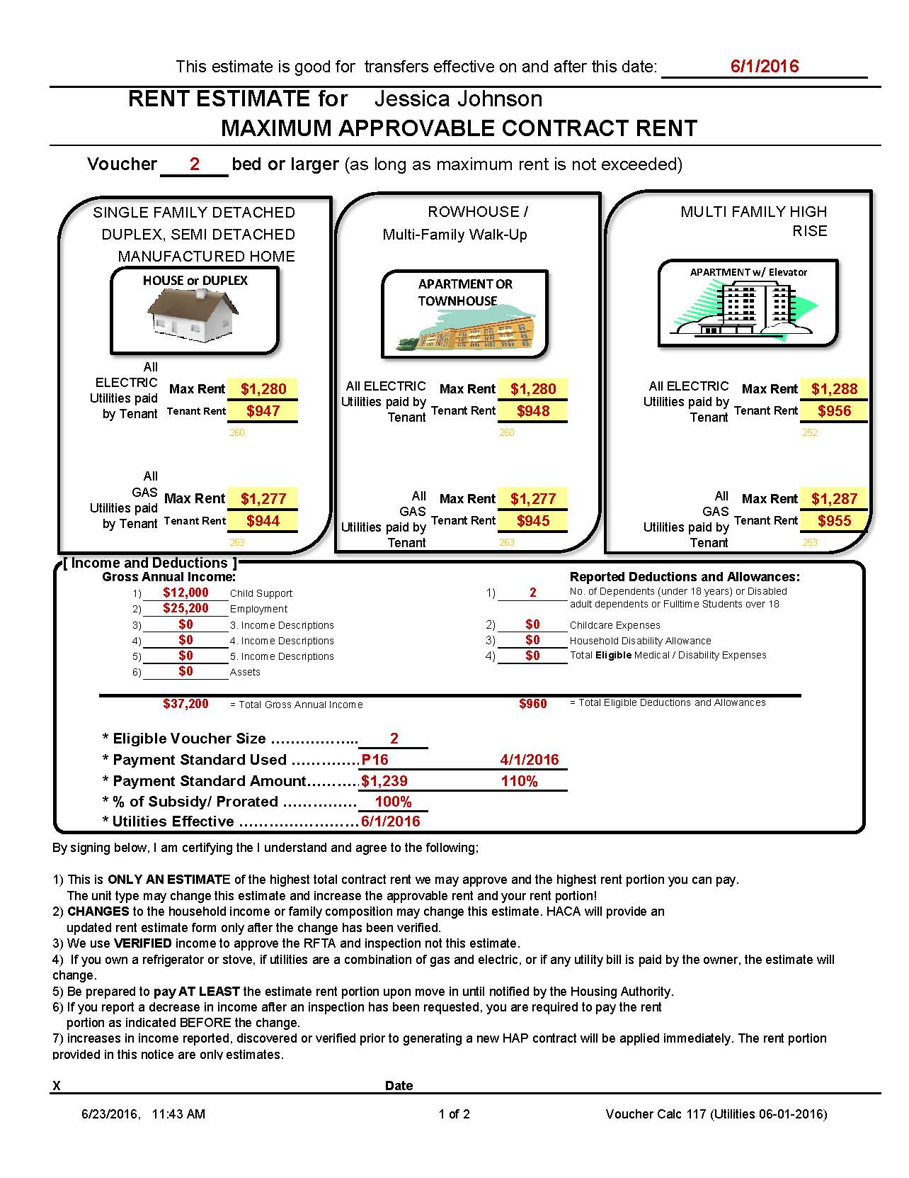
Understanding Your
Rent Estimate
Your estimate is calculated based on your income, deductions, and household composition.
Voucher size is issued strictly in accordance with program rules and number of people in the household, but you may be able to afford a larger bedroom size.

Slide 21
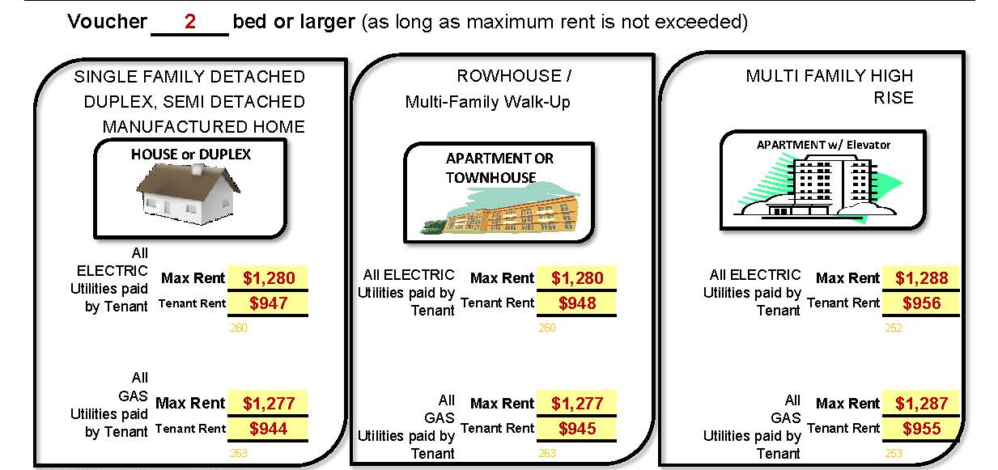
Estimates shown reflect tenant paying all utilities. *(If the landlord pays for utilities, your portion may be higher.)
Unit rent must not be higher than maximum amount listed.
At move-in, you will pay the amount listed as “tenant rent” on the estimate to your landlord.

Slide 22
Actively Search for Unit
Begin the search for your new home TODAY! Do not wait!
Where can you look for properties?
Rental Listings
Apartment Locating Services
Realtors
GoSection8.com
Any property owner who agrees to comply with the terms of the HAP contract can participate.

Slide 23
Voucher Expirations & Extensions
You must locate a suitable unit and turn in the moving packet within the 120 day deadline.
Extensions beyond 120 days may be granted as a reasonable accommodation for people with disabilities or due to extenuating circumstances.
Requests for extensions must be in writing and received by HACA before the voucher expires.

Slide 24
Portability
Take your voucher assistance with you!
HCV is a federal program. You may transfer your assistance to any other city that has a HCV program.
If you are planning to port, please let your Intake Housing Eligibility Specialist know as soon as possible.
The transfer process is timely. Some housing authorities require a 60 day minimum voucher to accept your transfer.

Slide 25
Find a Unit and Turn in RTA Packet
I found a unit! What next?
Inspect the actual unit. Check the neighborhood, the grounds, and approve the cosmetic condition such as carpet, the features, the paint, the exterior, etc.
Complete rental application. Pay application fees, security deposits, and agree to the landlord’s screening process, if any.
Once landlord approves you for tenancy, have them complete the Request for Tenancy Approval (RFTA) packet.
Make sure the packet is turned into HACA.

Slide 26
HCV Lease- Up Process
Actively Search for a Unit
Find a Unit & Turn in RTA Packet
Voucher Extension
Attend Initial Orientation
KEY
= Tenant
= HACA/Intake Team
= HACA/Inspection Team
= Landlord

Slide 27
Intake Team confirms unit affordability and requests inspection.
Inspection Team conducts rent reasonableness survey to assure that rent amount for unit is reasonable compared to other similar units in the private rental market. The inspector will inform the landlord if rent is approved.
Assigned inspector contacts landlord to schedule a Housing Quality Standards (HQS) inspection.
Inspections can take up to 7 days to schedule and complete.
HACA receives RTA Packet
Inspection Dept. Gets Inspection Request

Slide 28
Inspector will physically inspect the unit and electrical components. Utilities must be connected.
If there are problems with the unit, inspections may take longer because landlord may need to complete repairs.
When the unit passes inspection, the inspector will inform the landlord.
Direct all questions regarding status of inspection to the inspector or landlord.
Unit Passes Inspection

Slide 29
HCV Lease- Up Process
Actively Search for a Unit
Find a Unit & Turn in RTA Packet
Voucher Extension
HACA (Intake Team) receives RTA Packet
Attend Initial Orientation
Inspection Request to Inspection Dept.
Unit Inspected
KEY
= Tenant
Unit Passes Inspection
= HACA/Intake Team
= HACA/Inspection Team
= Landlord

Slide 30
MOVING IN!
Family can move in after inspection passes.
Contact landlord for status of inspection and permission to move in.
Do not move in before inspection passes or before landlord has approved the rent.
At move in, pay the amount listed on your rent estimate.
Read and understand the lease before you sign it.
HACA cannot assist in breaking your lease. Check your lease for information on moving early or re-letting fees.
Tenant Moves Into Unit

Slide 31
Process the paperwork. Prepare the Housing Assistance Payment (HAP) contract and rent notice.
Contract e-mailed to landlord and signed.
Notice of finalized tenant and HACA rent portions mailed to family and landlord. At move-in pay amount on rent estimate to avoid late fees.
Payment to the landlord may take 30 – 45 days after the inspection passes.
Intake Team Receives Inspection
Landlord Signs HAP Contract
HAP Paid to Landlord/
File to HCV Team

Slide 32
HCV Lease- Up Process
Actively Search for a Unit
Find a Unit & Turn in RTA Packet
Voucher Extension
HACA (Intake Team) receives RTA Packet
Attend Initial Orientation
Inspection Request to Inspection Dept.
HAP Paid to Landlord/
File to HCV Team
Success!
Unit Inspected
Landlord Signs HAP Contract
KEY
= Tenant
Inspection to Intake Team
Unit Passes Inspection
= HACA/Intake Team
Tenant Moves Into Unit
= HACA/Inspection Team
= Landlord

Slide 34
Final Tips
Start your housing search early.
Request an extension on your voucher before it expires.
If your income or household composition changes, report it as soon as possible.
Take advantage of the opportunities available to you through HACA that extend beyond housing.
“Bringing Opportunity Home”

